Slide 1
Regression: Contact Session 2
Dr. Chetana Gavankar, Ph.D,
IIT Bombay-Monash University Australia
Chetana.gavankar@pilani.bits-pilani.ac.in

Slide 2
Contact Session 2
Date – 12/04/2020
Time – 10am to 12pm

Slide 3
Topics to be covered
Module 2: Building Simple Linear Regression Models
Mathematical Foundations 1 – Maxima and minima of function of one variable
Mathematical Foundations 2 – Matrix rank, Eigen values and Eigen vectors, Positive & Negative definite/semi- definite matrices
Mathematical Foundations 3 - Maxima and minima of function of several variables
Convexity of errors function
Building simple linear regression model by solving normal equations
Gradient descent algorithm
Gradient descent algorithm for a simplistic case
Gradient descent, stochastic & mini-batch gradient descent algorithms

Slide 4
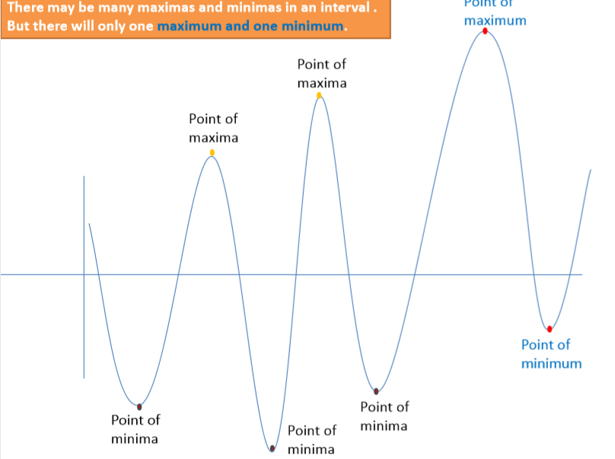
Maxima and Minima

Slide 5
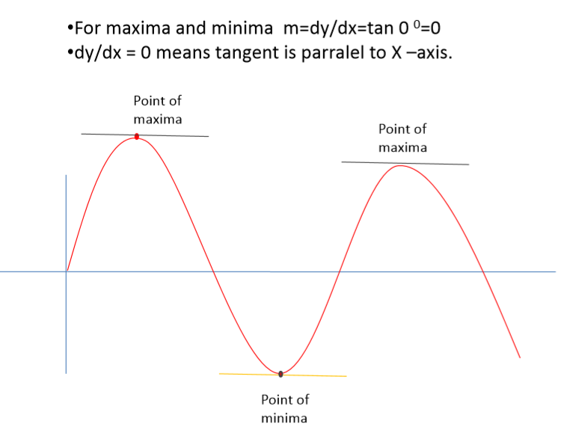
Maxima and Minima

Slide 6
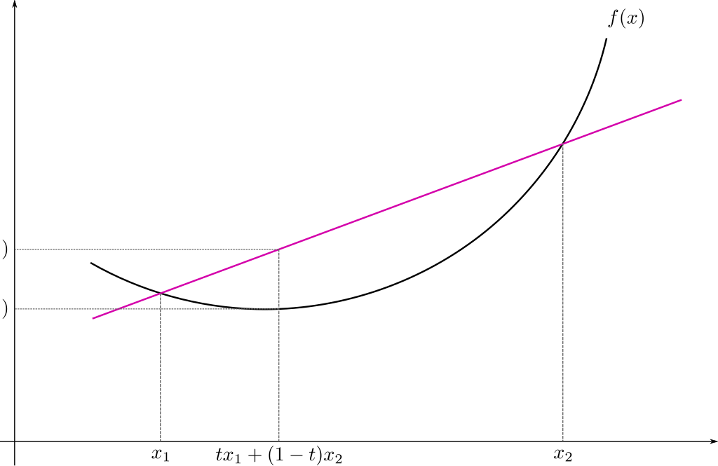
Convex Function

Slide 7
Convex Function
Real-valued function defined on an
n-dimensional interval is called convex if the line segment between any two points on the graph of the function lies above or on the graph

Slide 8
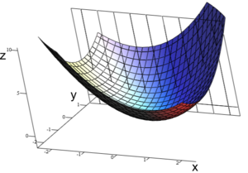
Convex Function : Multivariate

Slide 9
Linear independence
Suppose we have a set of vectors v₁, …, v_{n}
If we can express v₁ as a linear combination of the other vectors v₂…v_{n}, then v₁ is linearly dependent on the other vectors.
The direction v₁ can be expressed as a combination of the directions v₂…v_{n}. (E.g. v₁ = .7 v₂ -.7 v₄)
If no vector is linearly dependent on the rest of the set, the set is linearly independent.
Common case: a set of vectors v₁, …, v_{n} is always linearly independent if each vector is perpendicular to every other vector (and non-zero)

Slide 10
Matrix Rank
Column/row rank
col-rank(A)=no. of linearly independent columns
row-rank(A)=no. of linearly independent rows
Rank of a matrix is the number of linearly independent rows or columns (whichever is smaller).

Slide 11
Matrix Rank
Rank of a matrix denotes the information content of the matrix.
The lower the rank, the lower is the "information content".
For instance, when we say a rank 1 matrix, the matrix can be written as a product of a column vector times a row vector

Slide 12
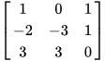
Matrix Rank : Example
Matrix has rank 2: the first two columns are linearly independent, so the rank is at least 2,
the third column is a linear combination of the first two (the second subtracted from the first), the three columns are linearly dependent so the rank must be less than 3

Slide 13
Eigenvalues and Eigenvectors
The vector x is an eigenvector of matrix A and λ is an eigenvalue of A if: Ax= λx
Eigenvalues and eigenvectors are only defined for square matrices (i.e., m = n)
Eigenvectors are not unique (e.g., if λ is an eigenvector, so is k λ)
Zero vector is a trivial solution to the eigenvalue equation for any number λ and is not considered as an eigenvector.
Interpretation: the linear transformation implied by A cannot change the direction of the eigenvectors λ, but change only their magnitude.
(assume non-zero x)

Slide 14
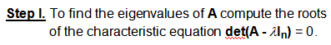
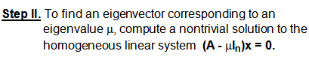
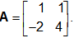
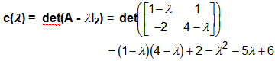
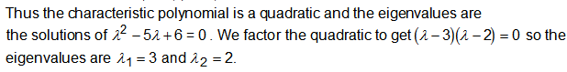
Eigenvalues and Eigenvectors
Example: Find Eigen pairs of
Step I. Find the eigenvalues.

Slide 15
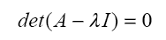
Computing λ and v
To find the eigenvalues λ of a matrix A, find the roots of the characteristic polynomial :
Ax= λx
Example:

Slide 16
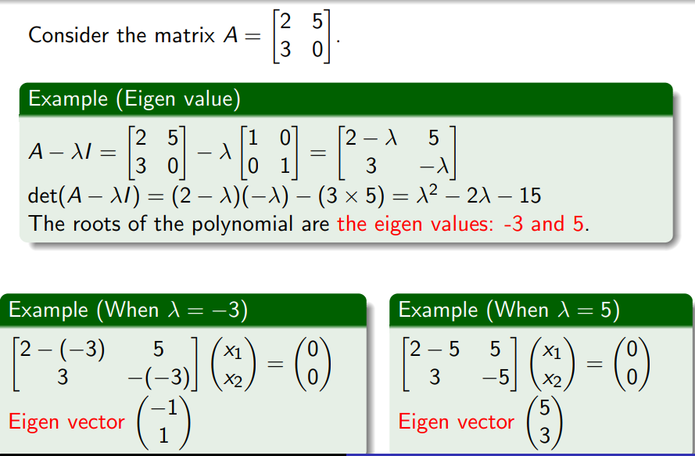
Computing λ and v

Slide 17
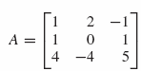
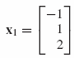
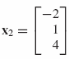
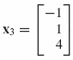
Example:
Find the eigenvalues and corresponding eigenvectors of
The characteristic polynomial is
Its factors are
So the eigenvalues are 1, 2, and 3.
Corresponding eigenvectors are

Slide 18
Positive Definite Matrices
THEOREM
A symmetric matrix A is positive definite
if and only if all the eigenvalues of A are positive.
EXAMPLE Showing That a Matrix Is Positive Definite
Solution
The characteristic equation of A is

Slide 19
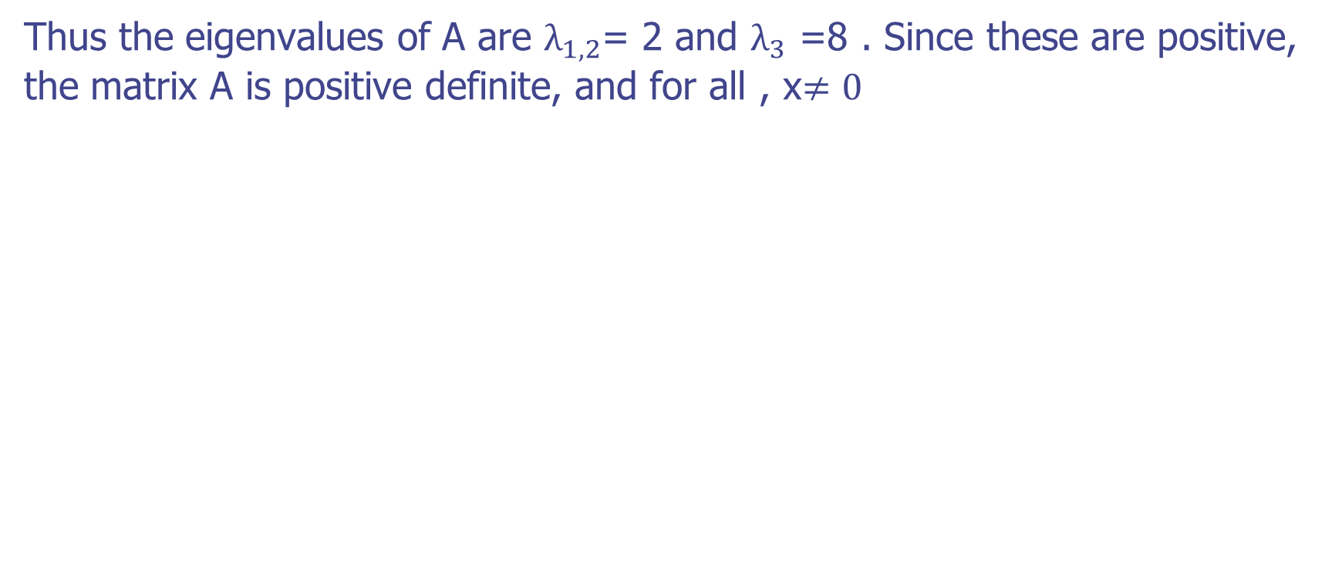
Positive Definite Matrices
Thus the eigenvalues of A are $λ_{1,2}$= 2 and $λ_{3}$ =8 . Since these are positive, the matrix A is positive definite, and for all , x$≠0$
Our next objective is to give a criterion that can be used to determine whether a symmetric matrix is positive definite without finding its eigenvalues.
To do this, it will be helpful to introduce some terminology.
If is a square matrix,

Slide 20
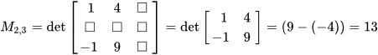
Matrix of Minors
Minor of a matrix A is the determinant of some smaller square matrix, cut down from A by removing one or more of its rows and columns.
Minors obtained by removing just one row and one column from square matrices

Slide 21
Leading Principal minor
If the matrix that corresponds to a principal minor is a determinant of quadratic upper-left part of the larger matrix (i.e., it consists of matrix elements in rows and columns from 1 to k), then the principal minor is called a leading principal minor (of order k)
The kth order leading principal minor is the determinant of the kth order principal submatrix formed by deleting the last n − k rows and columns.

Slide 22
Positive Definite Matrices
The principal leading minor of A are the submatrices formed from the first r rows and r columns of A for .
These submatrices are
THEOREM
A symmetric matrix A is positive definite
if and only if
the determinant of every leading principal minor is positive.

Slide 23
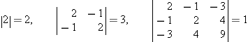
Positive Definite Matrices
EXAMPLE Working with Principal minors
The matrix
is positive definite since
all of which are positive.
Thus we are guaranteed that all eigenvalues of A are positive

Slide 24
Positive Definite Matrices
Example- Is the following matrix positive definite?

Slide 25
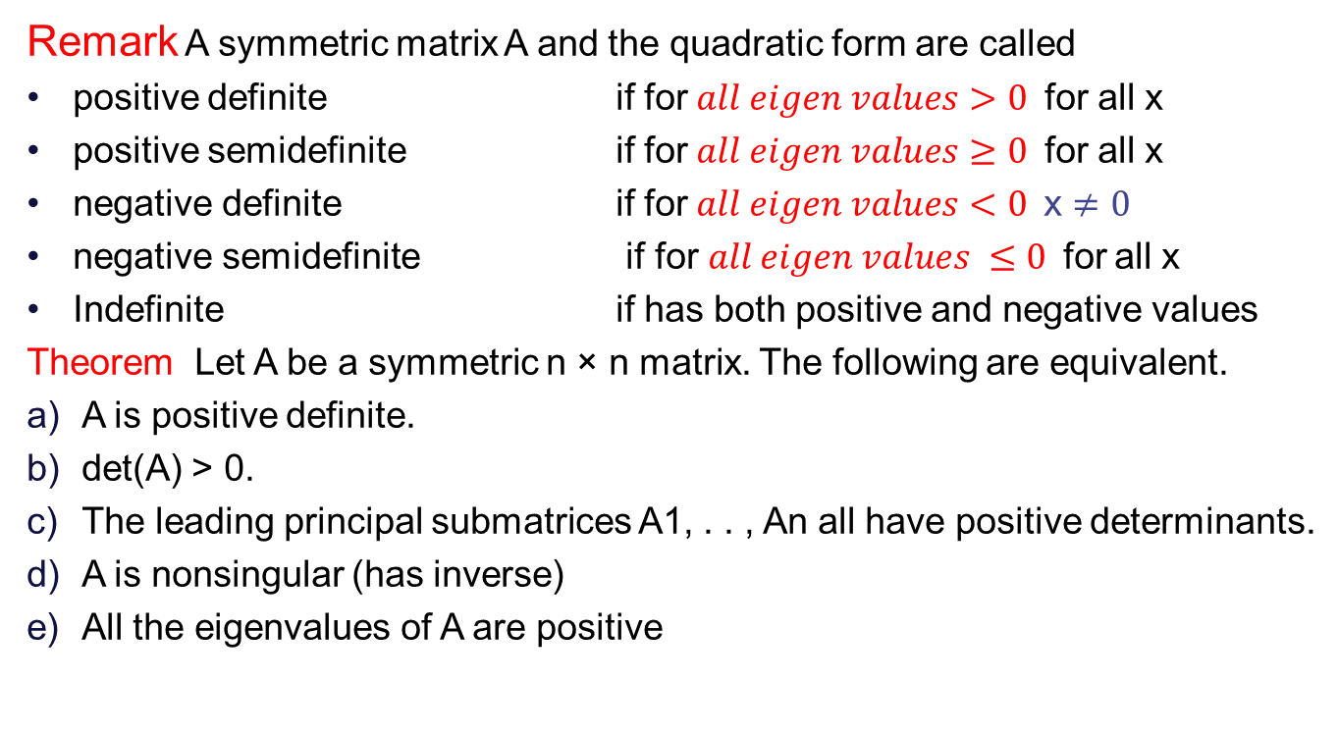
Positive & Negative definite/ semi- definite matrices
Remark A symmetric matrix A and the quadratic form are called
positive definite if for$all eigen values>0$ for all x
positive semidefinite if for$all eigen values≥0$ for all x
negative definite if for$all eigen values<0 \text{x}≠0$
negative semidefinite if for$all eigen values ≤0$for all x
Indefinite if has both positive and negative values
Theorem Let A be a symmetric n × n matrix. The following are equivalent.
A is positive definite.
det(A) > 0.
The leading principal submatrices A1, . . , An all have positive determinants.
A is nonsingular (has inverse)
All the eigenvalues of A are positive

Slide 26
Indefinite Matrices
Example
All of the principal minors are nonnegative (1,0,0) A is not positive Semi definite; it is actually indefinite because we have eigenvalues positive and negative

Slide 27
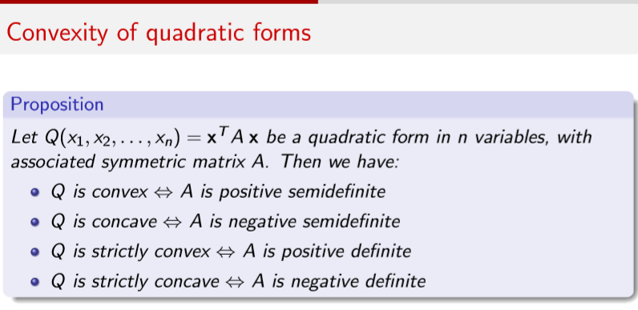
Convexity of function

Slide 28
Linear Regression
Predicting sales of an item
Advertising (in lakhs of rupees) | Sales (in lakhs of rupees)
10 | 520
20 | 625
35 | 700
50 | 780

Slide 29
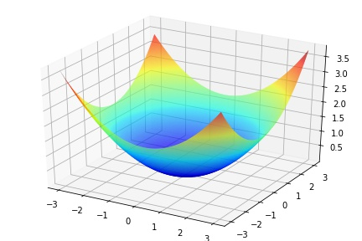
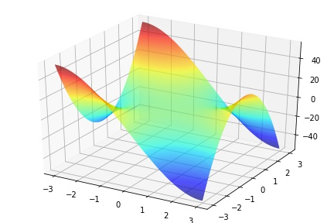
Linear Regression

Slide 30
Linear Regression

Slide 31
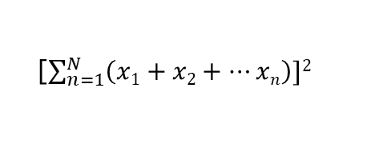
Linear Regression
[$\sum_{n=1}^{N}{\left(x1+x2+…xn\right)]2}$

Slide 32
Linear Regression using normal equations

Slide 33
Linear Regression using normal equation

Slide 34
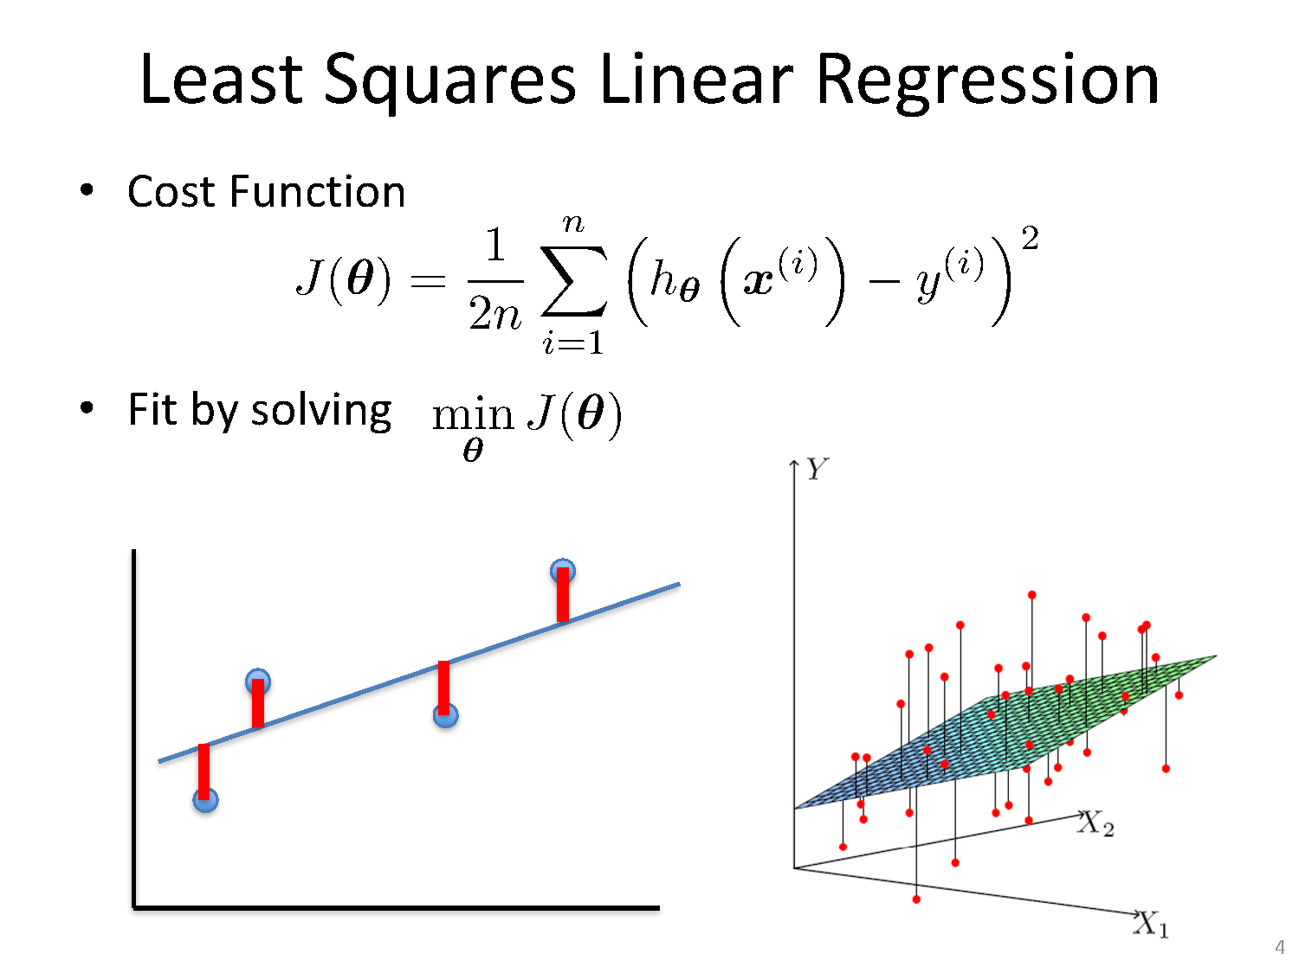

Slide 35
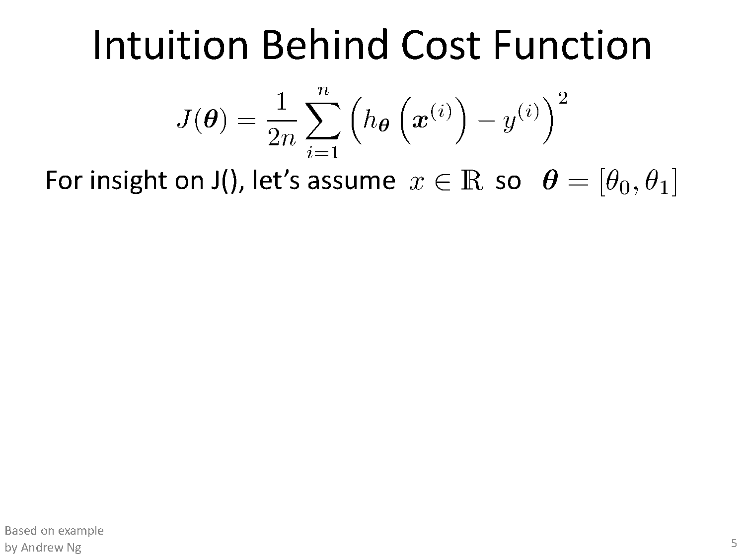

Slide 36
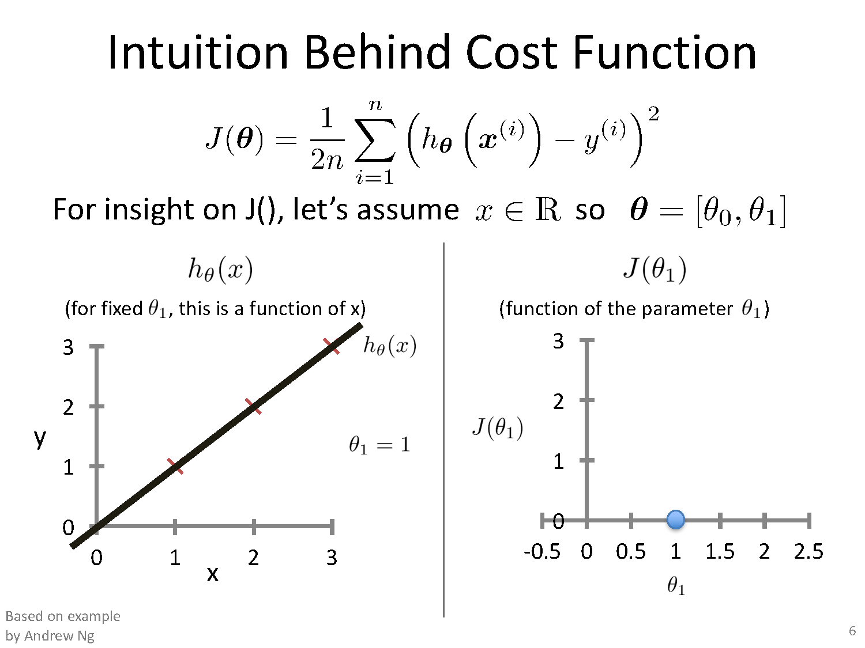

Slide 37
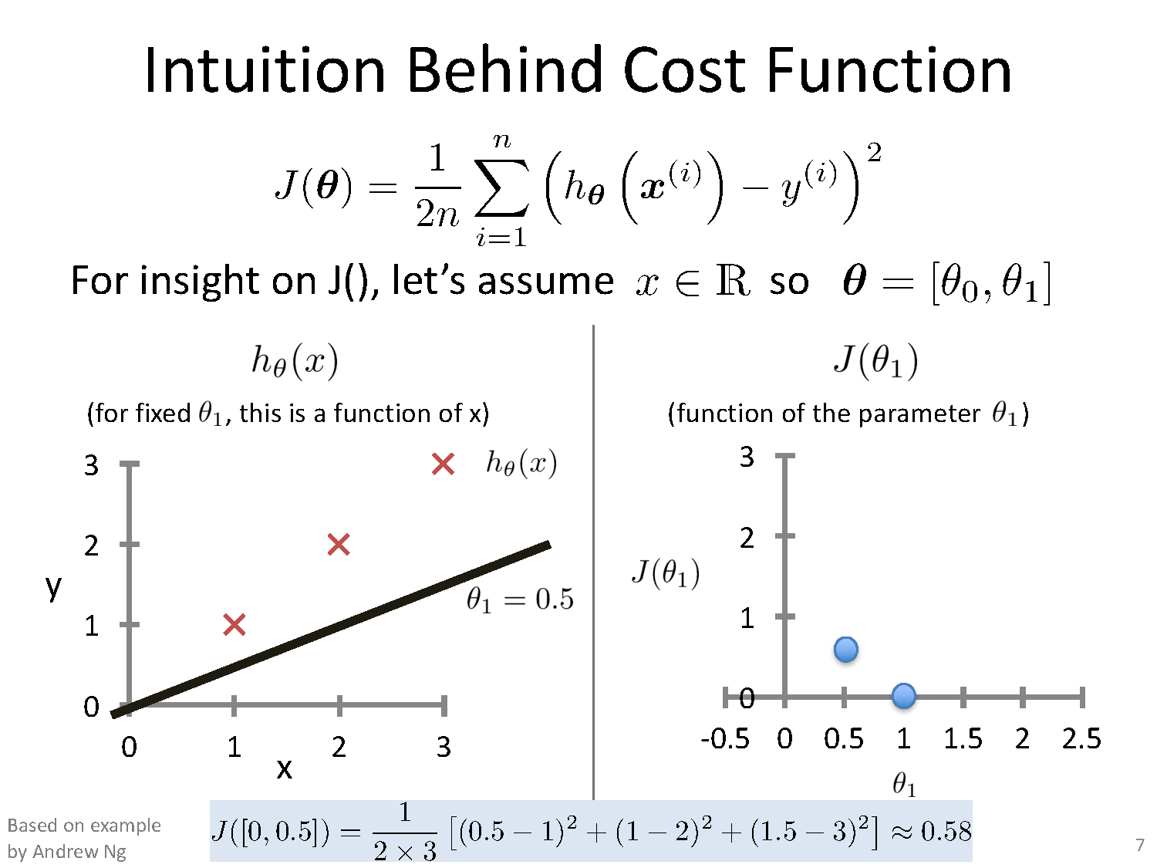

Slide 38
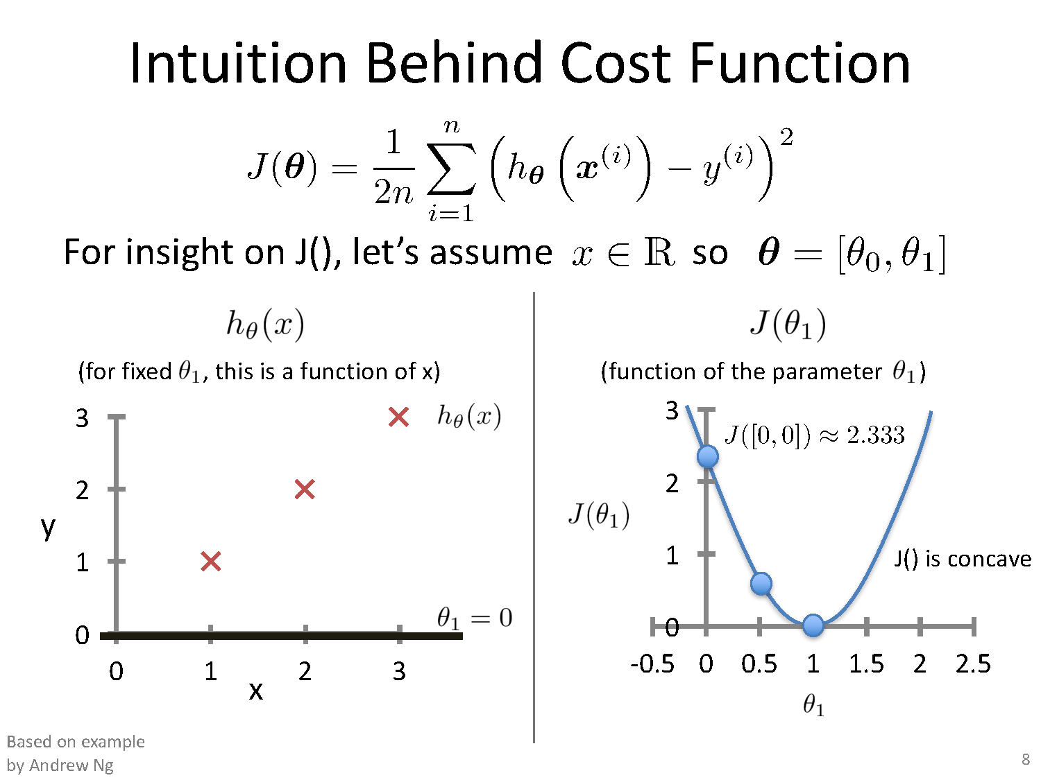

Slide 39
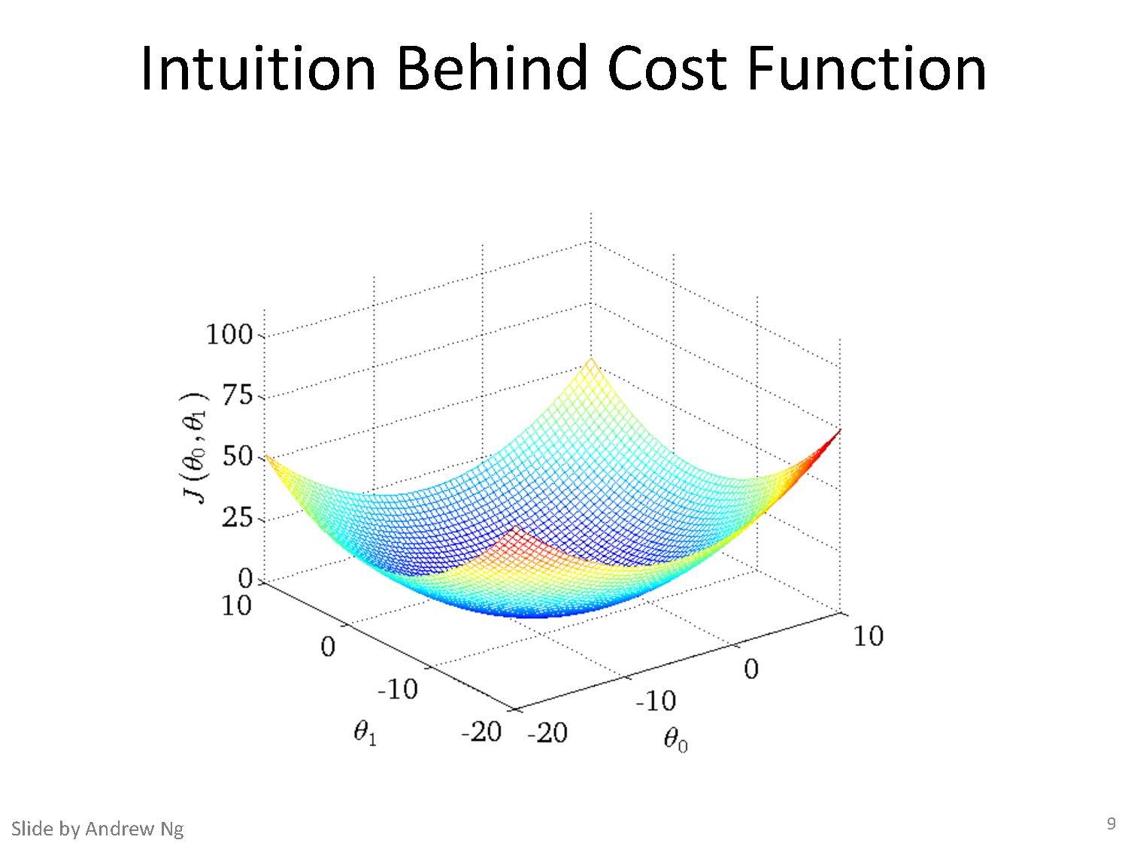

Slide 40
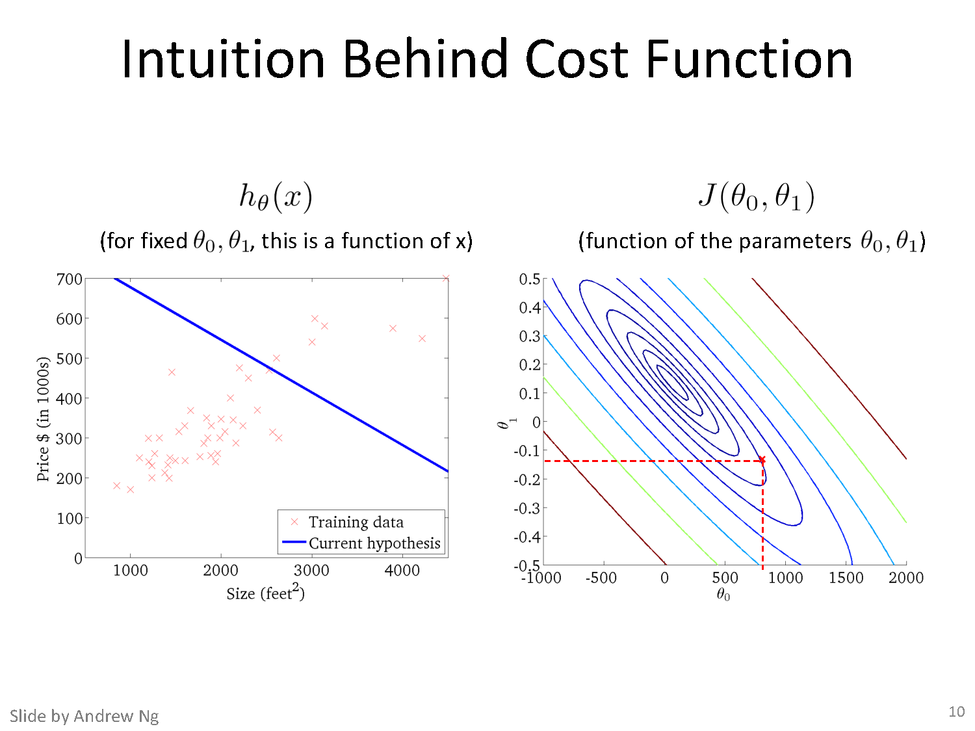

Slide 41
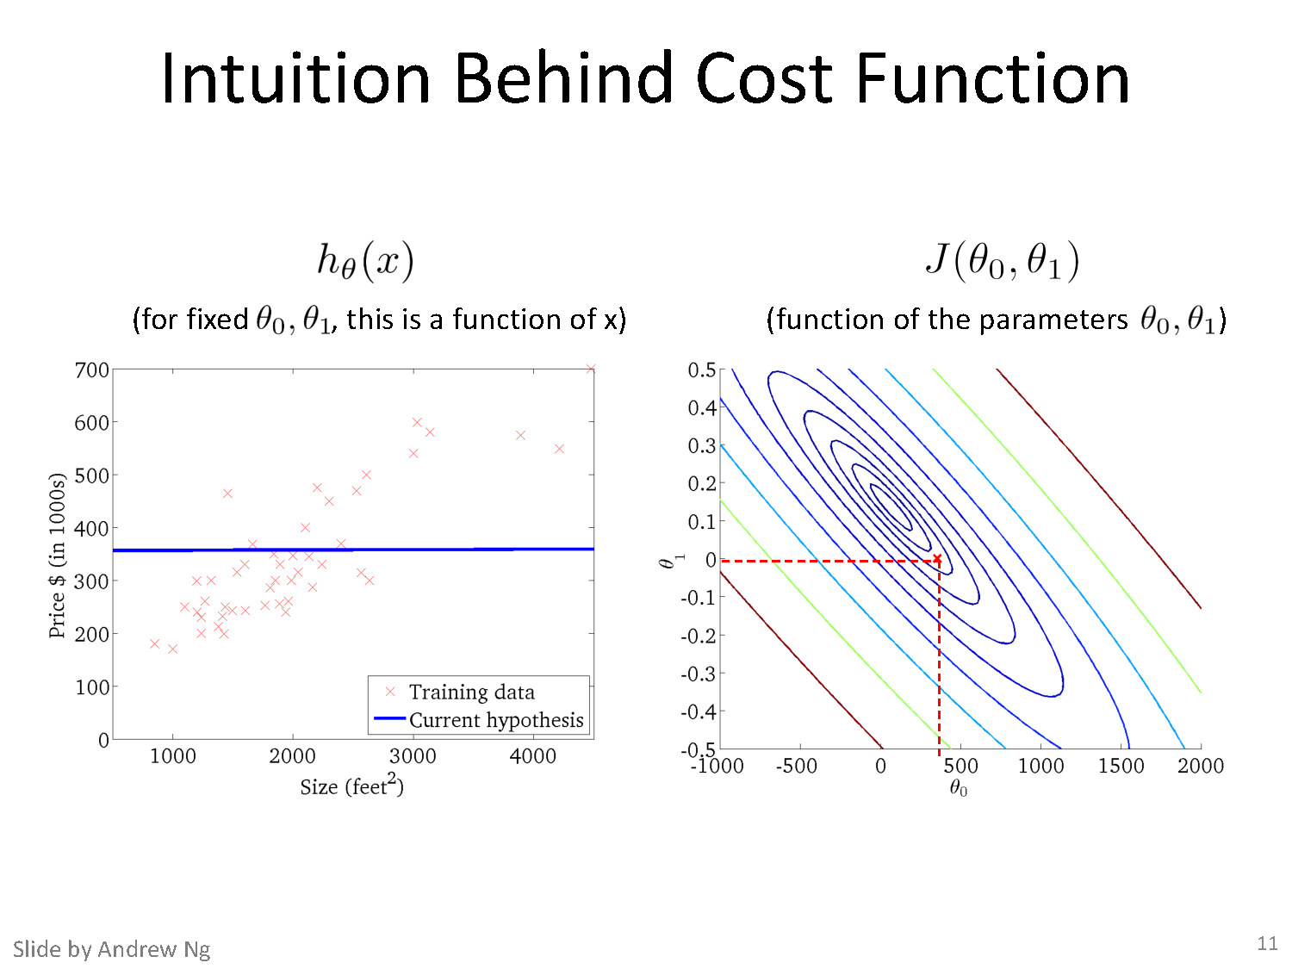

Slide 42
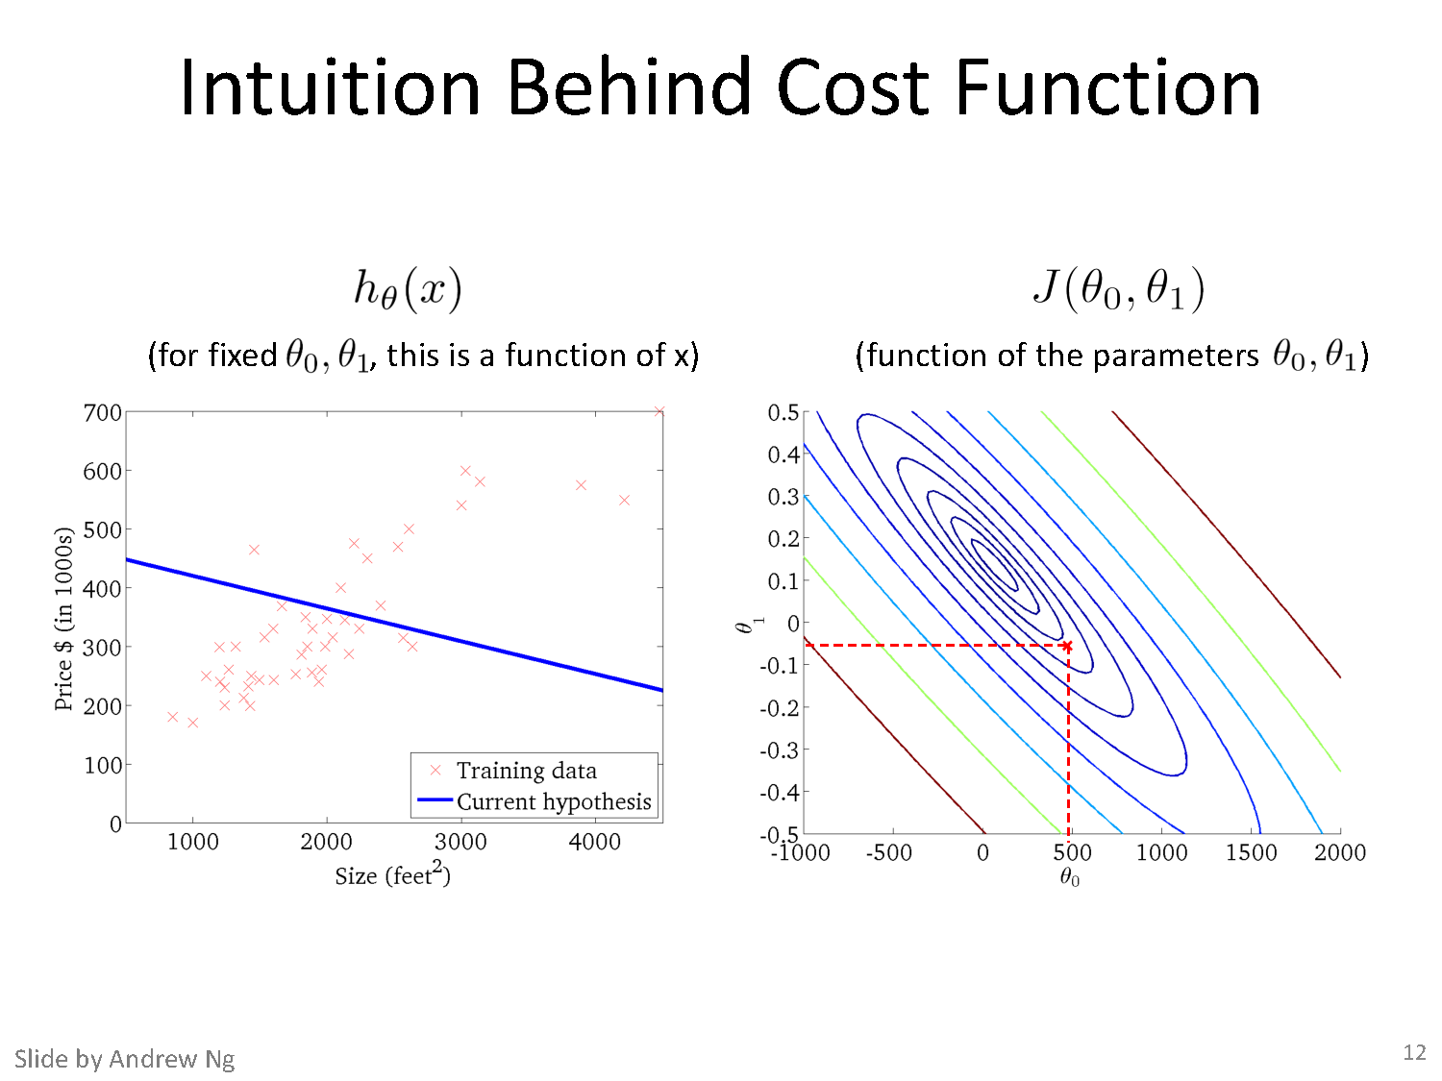

Slide 43
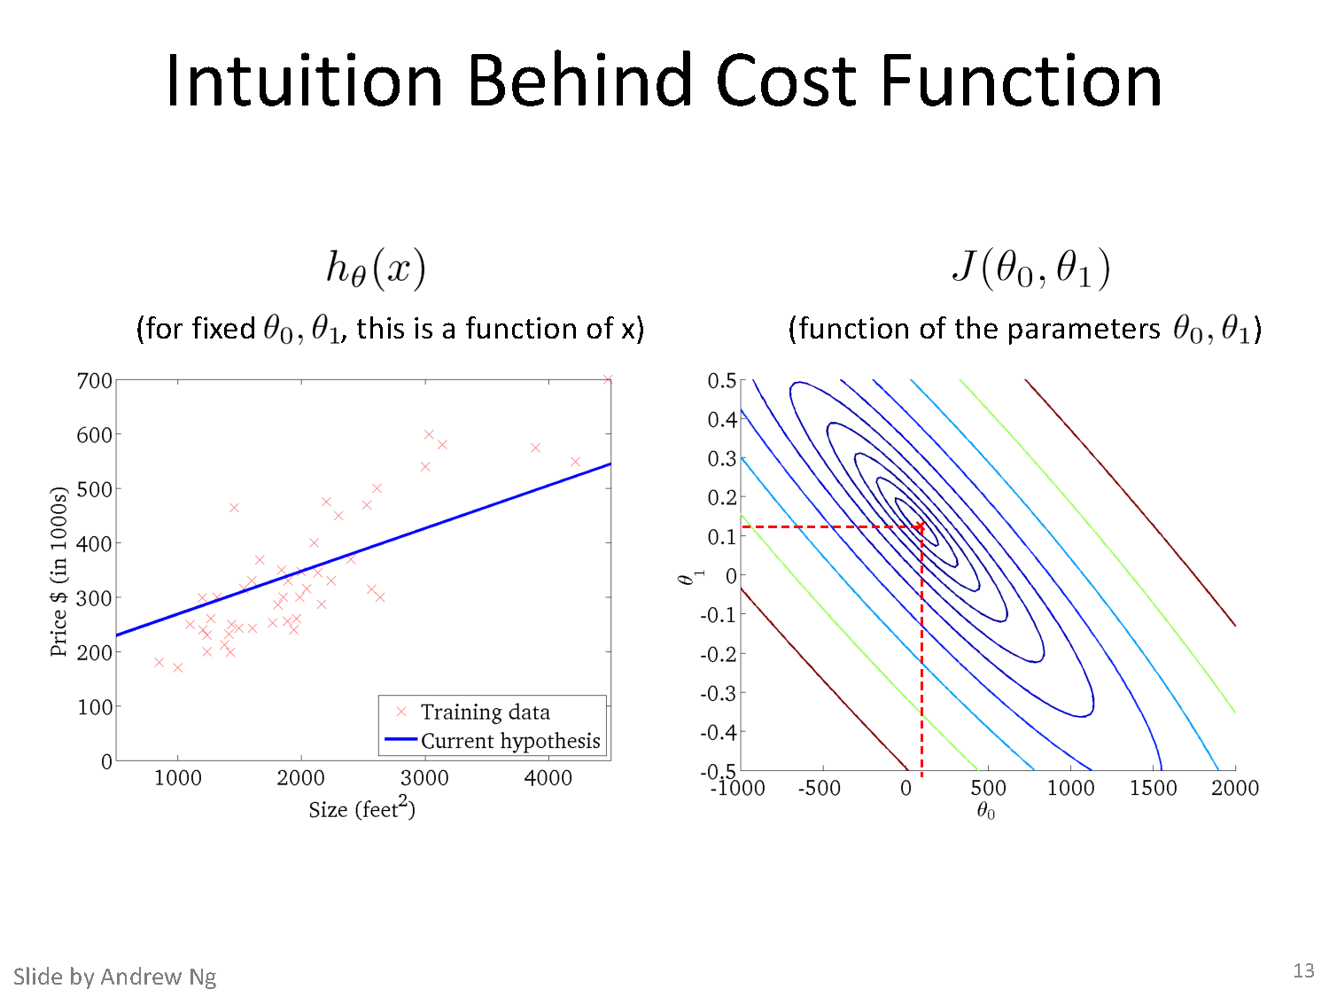

Slide 44
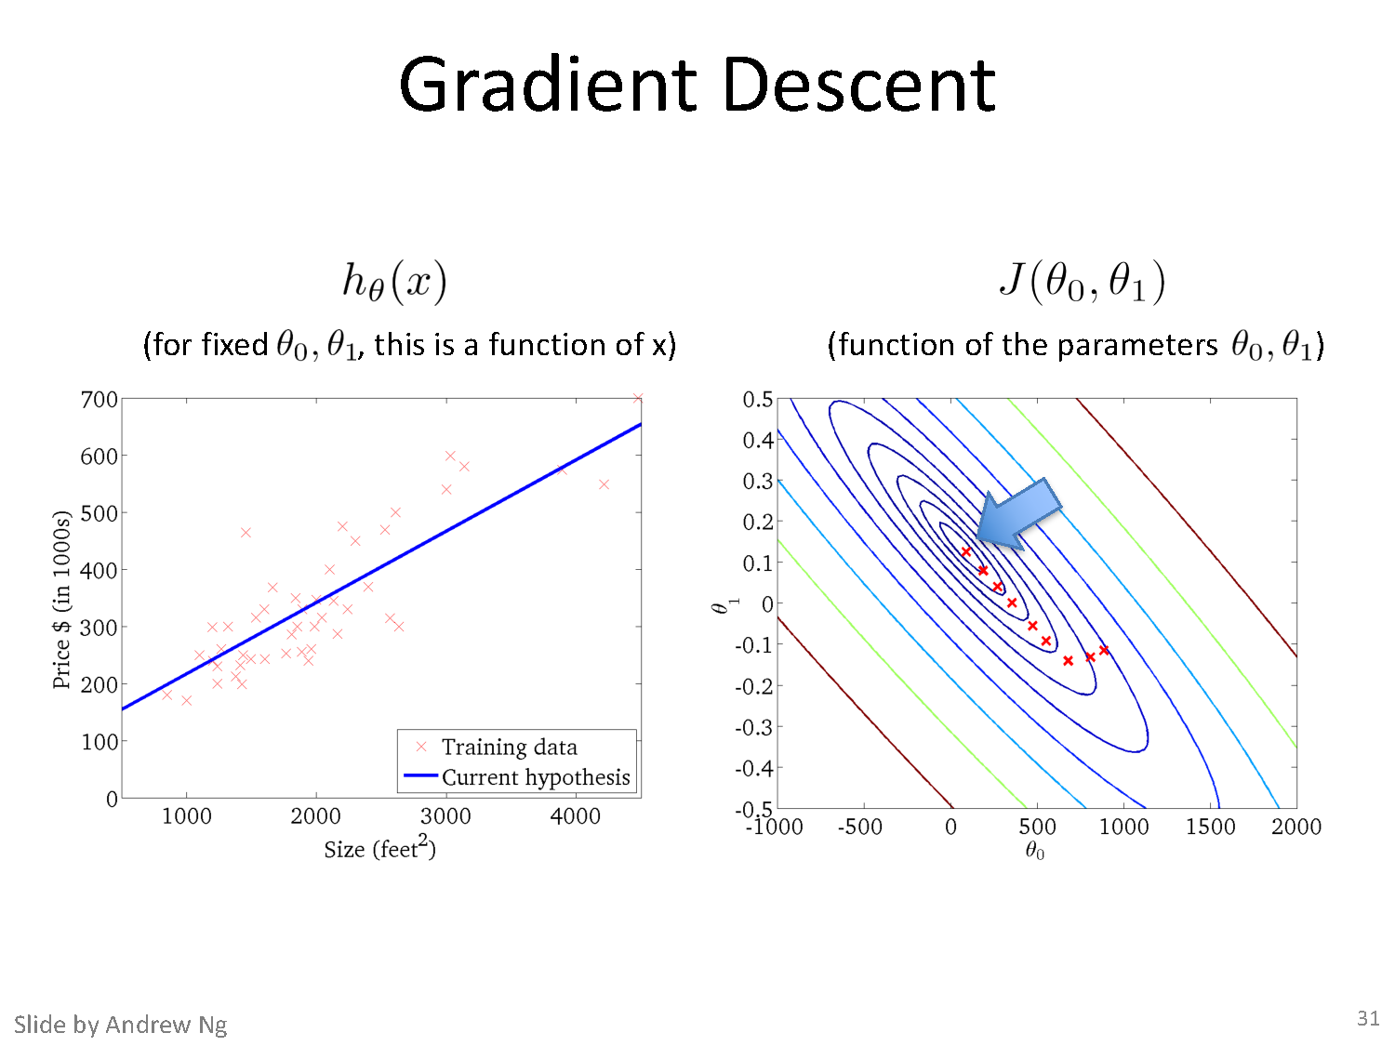

Slide 45
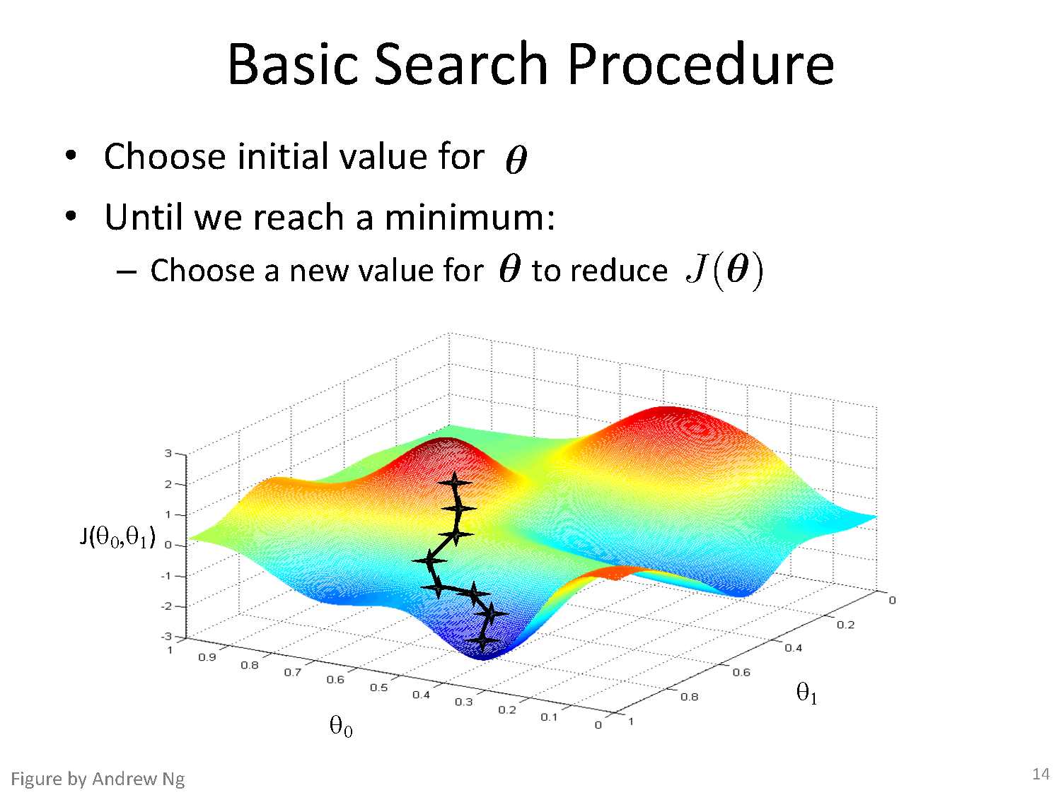

Slide 46
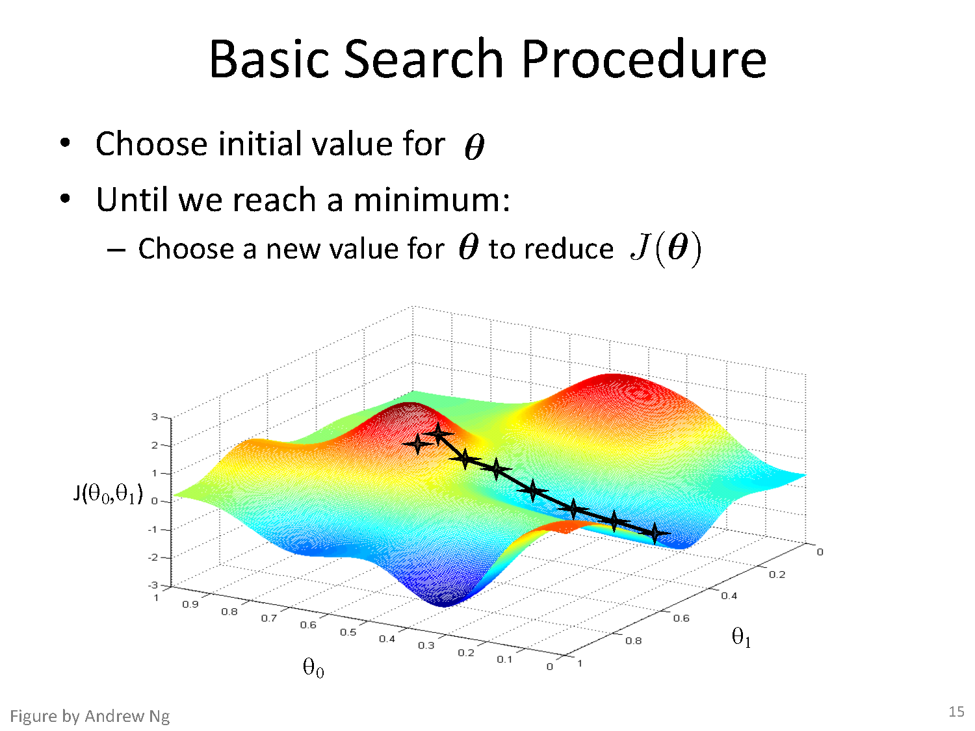

Slide 47
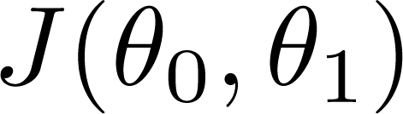
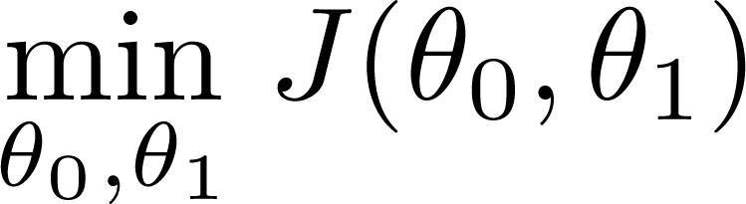
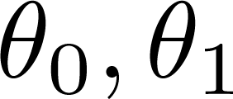
Have some function
Want
Outline:
Start with some
Keep changing to reduce until we hopefully end up at a minimum

Slide 48
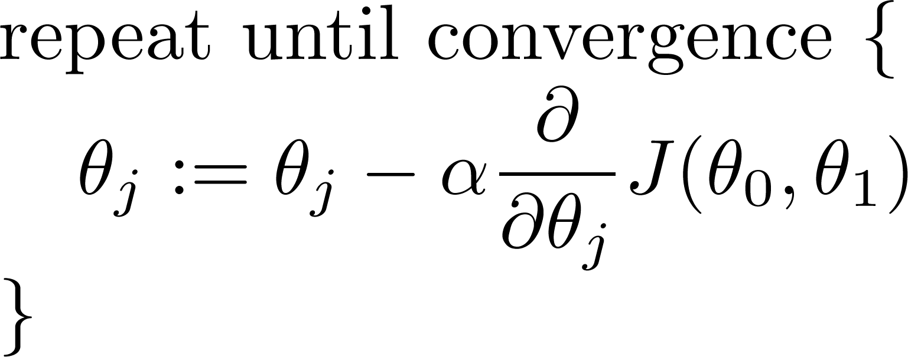
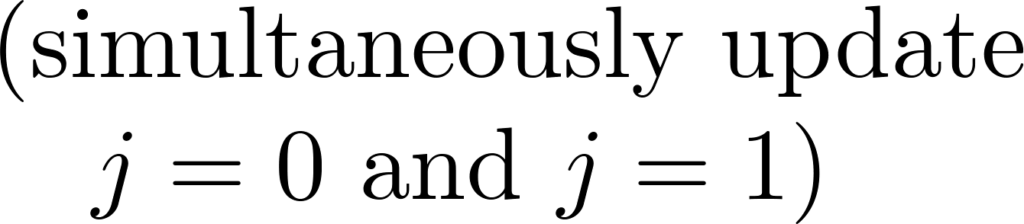
Gradient descent algorithm

Slide 49
Gradient Descent: Loss with only one parameter θ₁
Slope = tan θ
tan θ > 0
; 0 < θ < 90
Slope = tan θ
tan θ < 0
; 90 > θ < 180

Slide 50
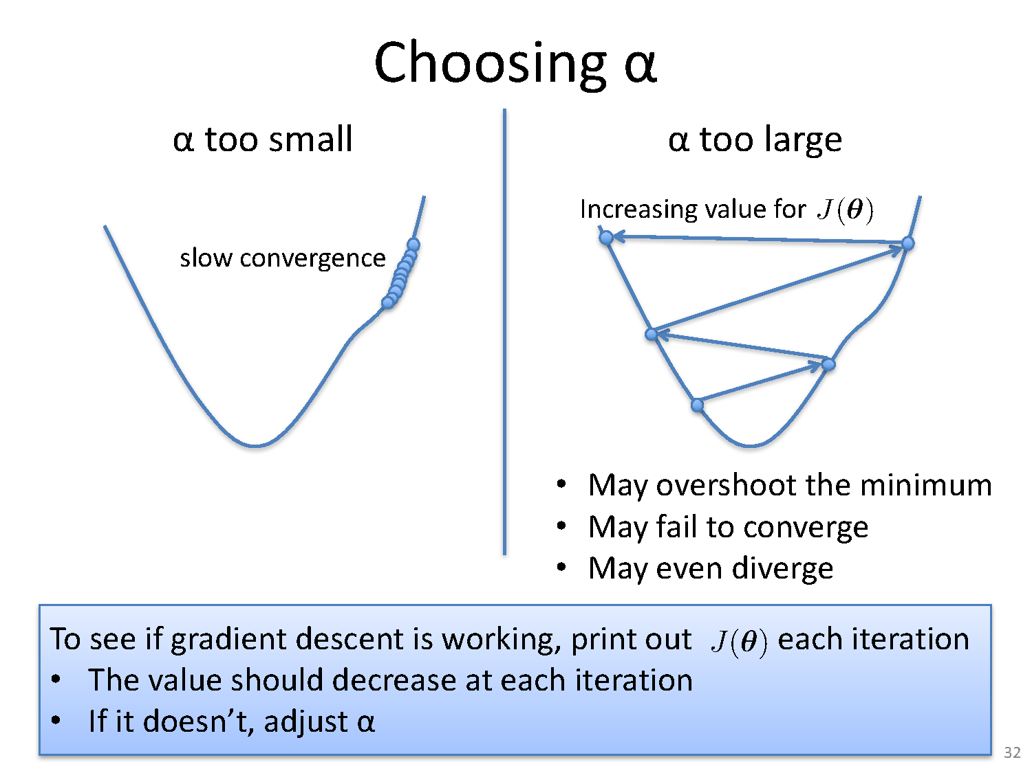

Slide 51
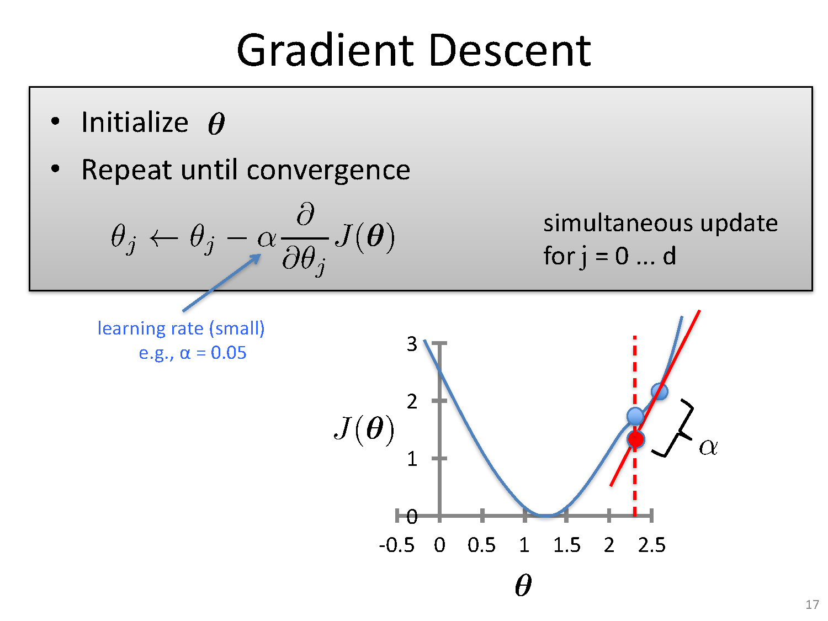

Slide 52
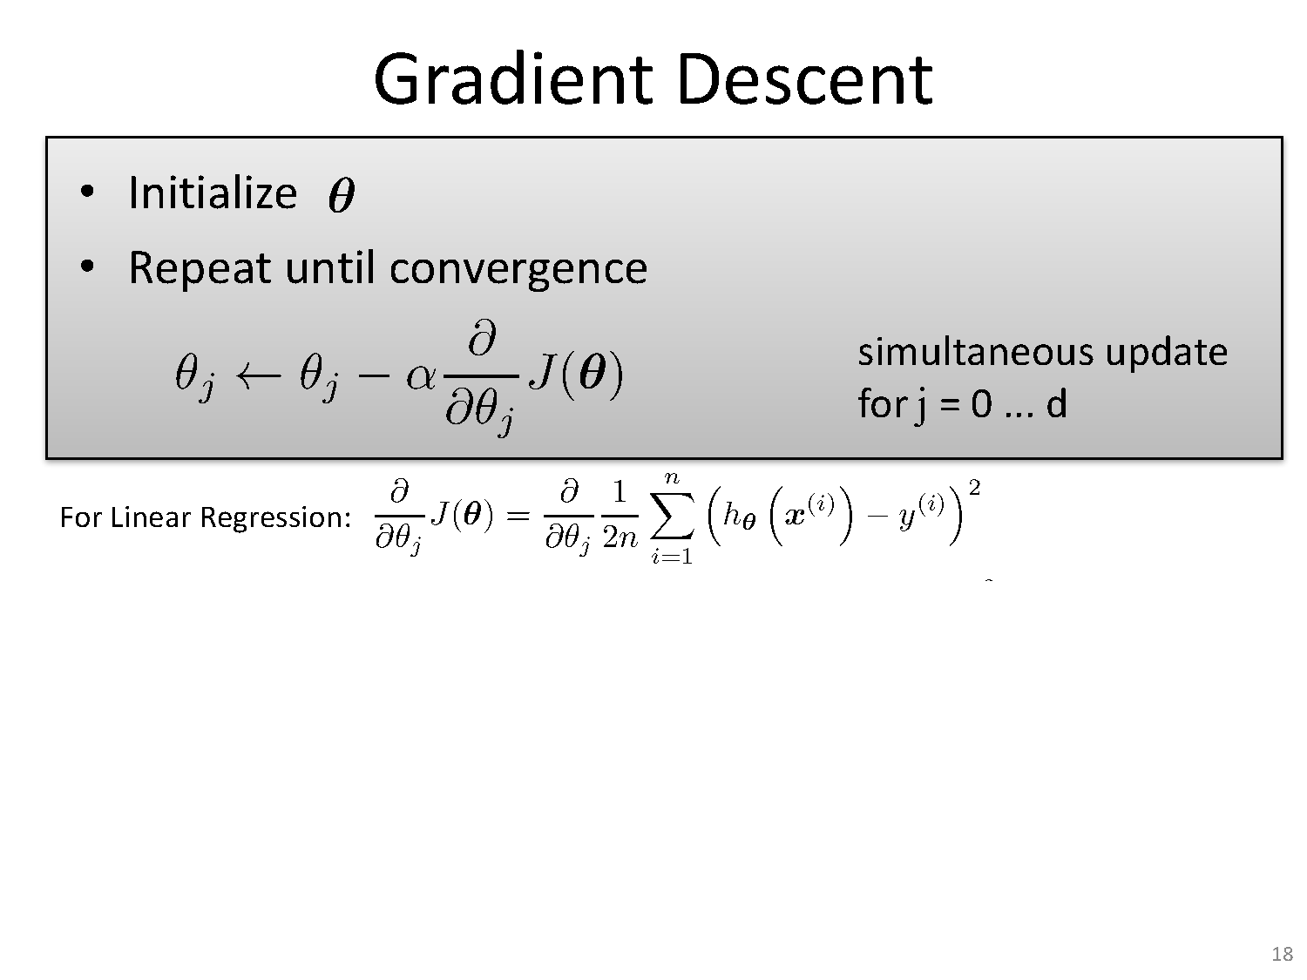

Slide 53
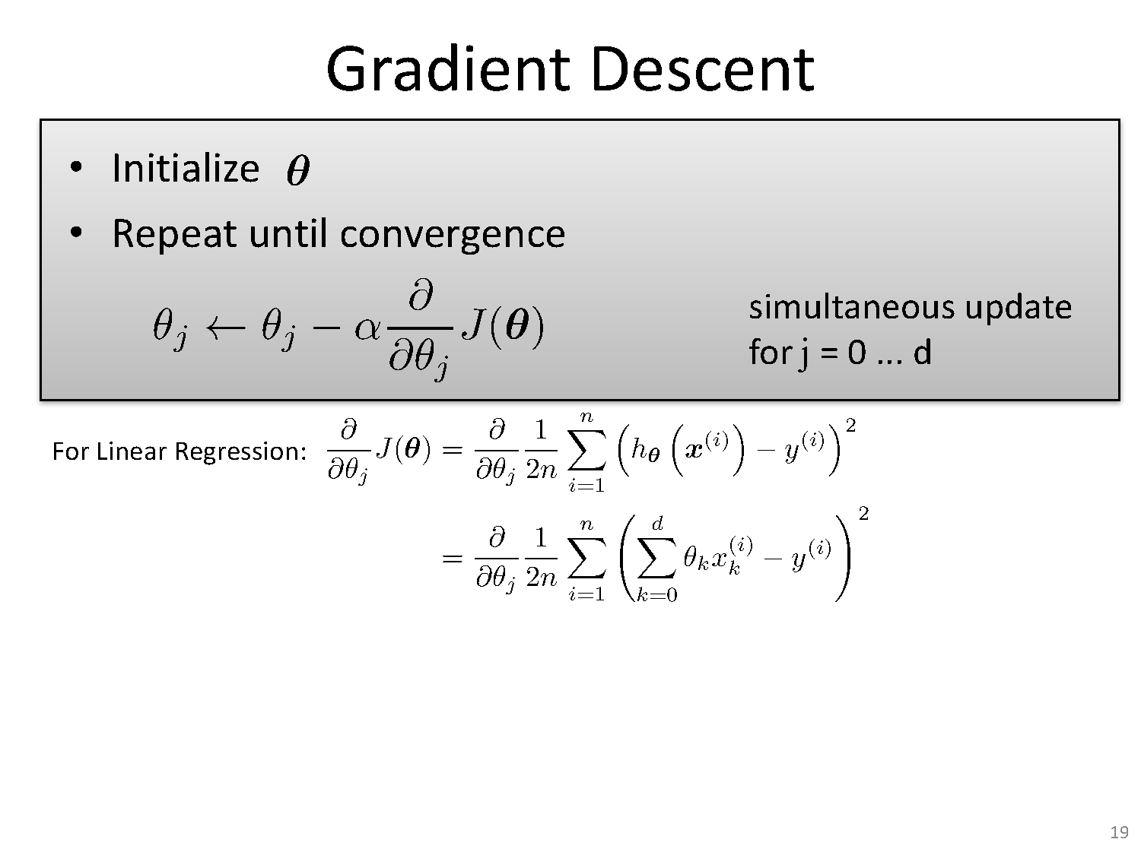

Slide 54
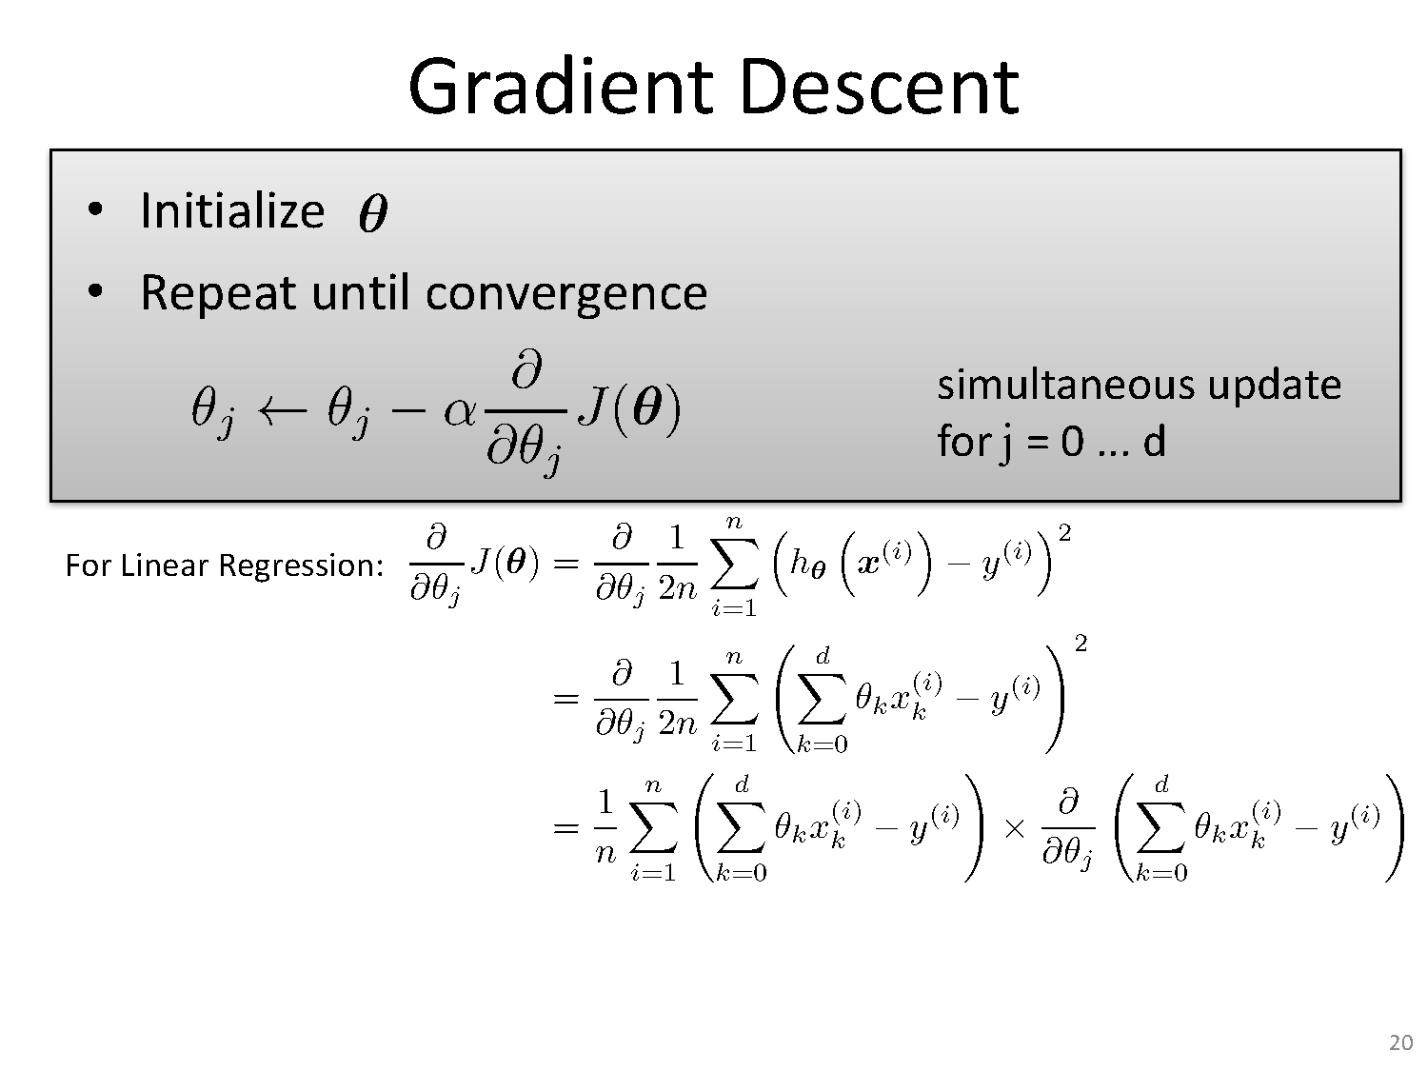

Slide 55
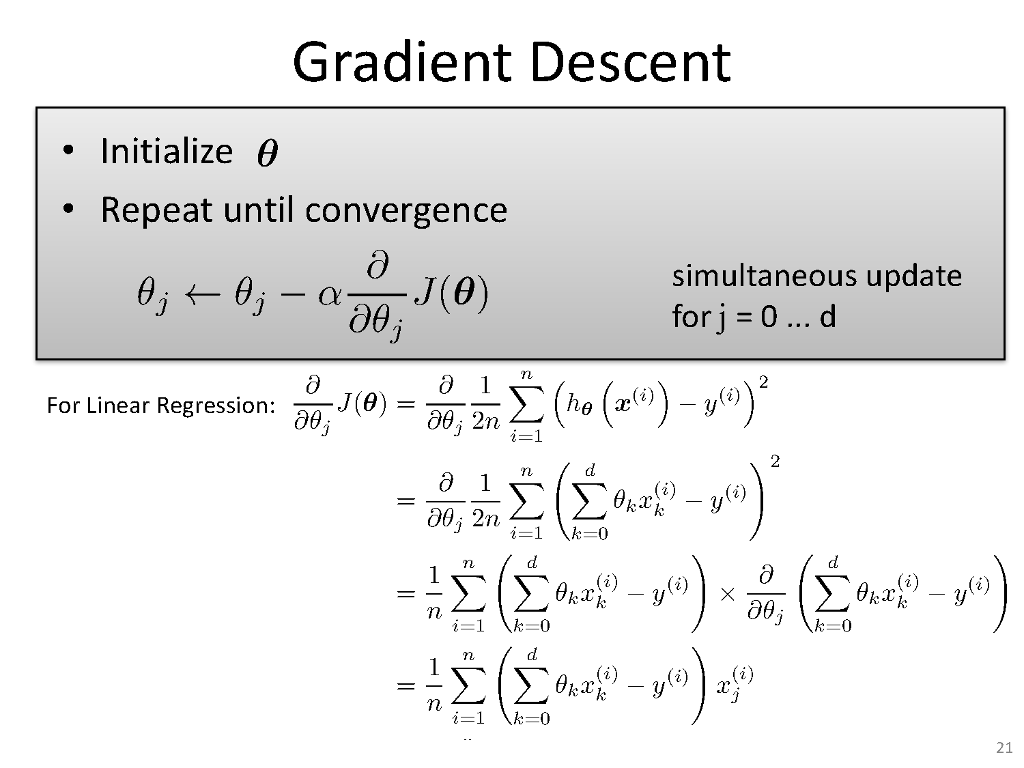

Slide 56
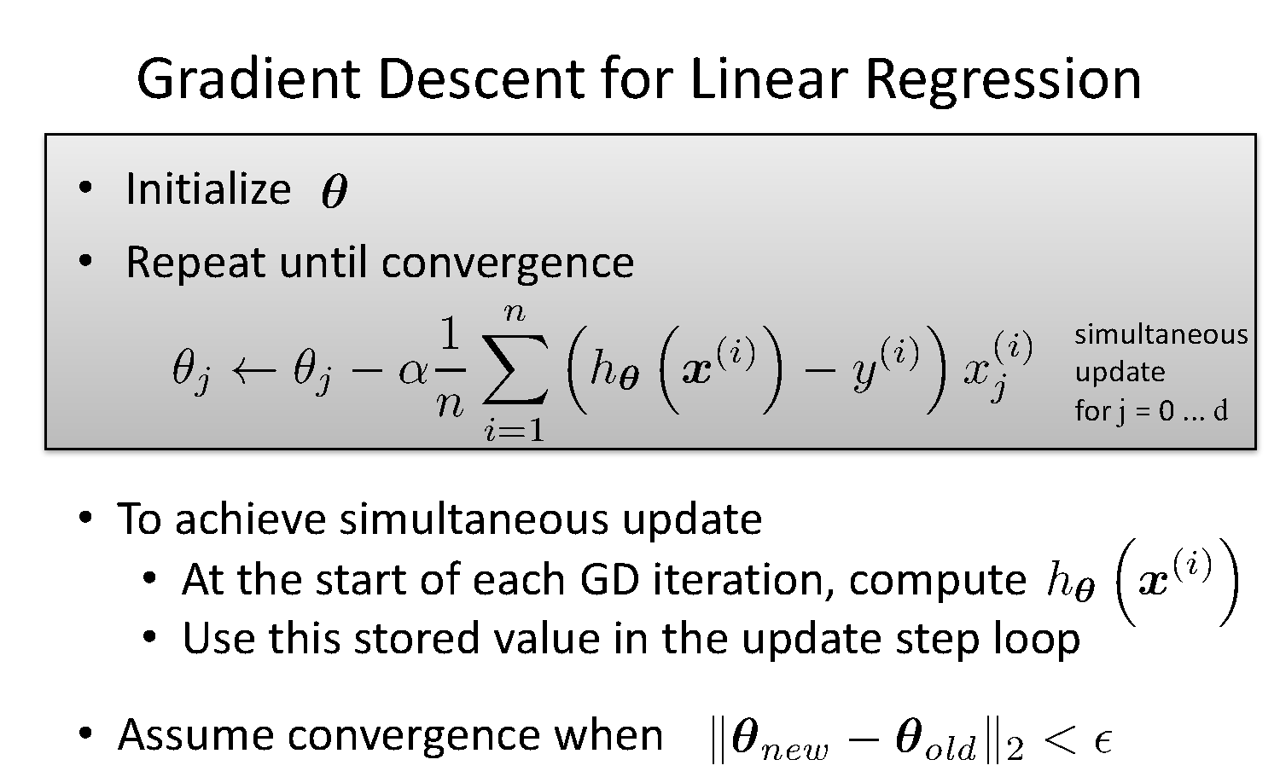

Slide 57
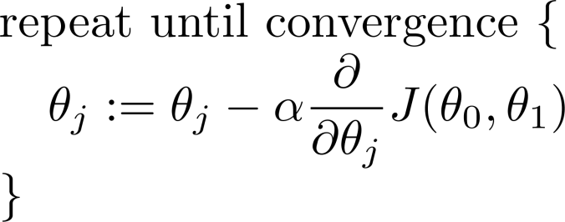



Gradient descent algorithm:
Simultaneous update
Correct: Simultaneous update
Incorrect:

Slide 58
Gradient Descent algorithm:
learning rate/ η (eta) /α (alpha) parameter
The learning rate value is a small real value such as 0.1, 0.001
The most commonly used rates are : 0.001, 0.003, 0.01, 0.03, 0.1, 0.3.
Try different values for your problem and see which works best.
Typically if you take high value of you may miss on minima and overshoot.
If you choose a very small eta, the algorithm will be very slow and will take many iterations to converge

Slide 59
Gradient Descent Algorithm

Slide 60
Stochastic Gradient Descent Algorithm

Slide 61
Mini-batch Gradient Descent Algorithm

Slide 62
Summary
Optimization is a big part of machine learning.
Gradient descent is a simple optimization procedure that you can use with many machine learning algorithms.
Batch gradient descent refers to calculating the derivative from all training data before calculating an update.
Minibatch refers to calculating derivative of mini groups of training data before calculating an update.
Stochastic gradient descent refers to calculating the derivative from each training data instance and calculating the update immediately

Slide 63
References
https://www.khanacademy.org/math/linear-algebra/alternate-bases/eigen-everything/v/linear-algebra-introduction-to-eigenvalues-and-eigenvectors
http://math.mit.edu/~gs/linearalgebra/ila0601.pdf
https://www.youtube.com/watch?v=xsP-S7yKaRA
https://textbooks.math.gatech.edu/ila/least-squares.html
https://towardsdatascience.com/batch-mini-batch-stochastic-gradient
https://www.coursera.org/lecture/machine-learning/gradient-descent-8SpIM-descent-7a62ecba642a

Slide 64
Thank You
12 April 2020

